Slide 1

SECA4002 – DEEP LEARNING NEURAL NETWORKS
Dr. V. Vedanarayanan B.E., M.E., PhD
Course Co-ordinator
Assistant Professor, Department of ECE,
School of Electrical and Electronics
SATHYABAMA INSTITUTE OF SCIENCE AND TECHNOLOGY

Slide 2

Topics To Be Covered in this Video Lecture are
Course Introduction
Course Objectives
Course Outcomes
Detailed Curriculum
Recommended Text Books/ Reference Books
Unit -1- Introduction to Machine Learning
Neural Networks –Working Principle
Training of Neural Networks
Loss Functions / Approximation functions of Artificial Neural Networks

Slide 3
Course Introduction
Part -1:
What is Artificial Neural Networks (ANN’s)?
Why we need ANN’s?
Applications of ANN’s
Part - 2:
What is Deep Learning?
Usefulness' Of Deep Learning Strategies
Applications of Deep Learning

Slide 4
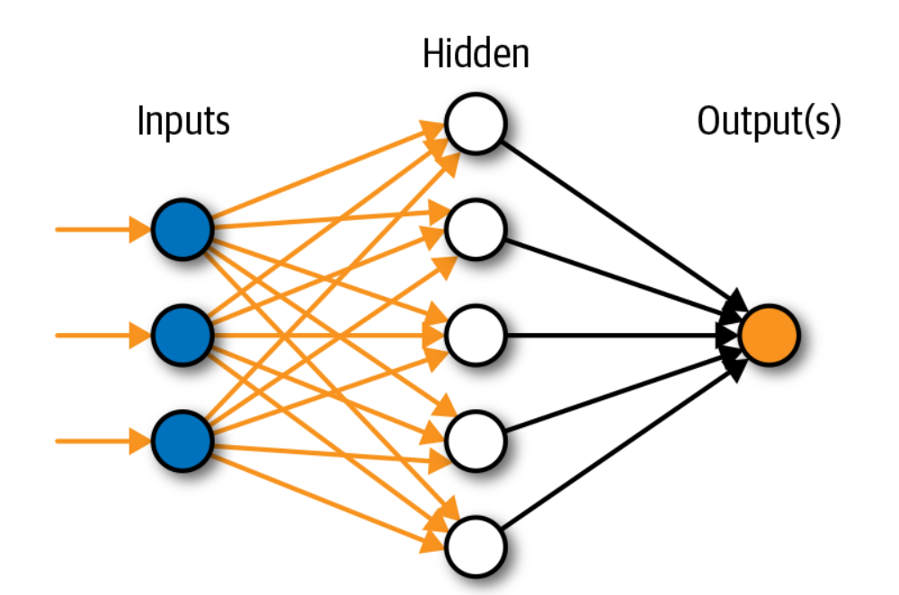
Course Introduction Continued
Artificial Neural Networks:
Artificial Neural Networks:
Interconnections of computing systems/processing units based on Biological neural system(BNN or BNS)
Image Source:https://www.innoarchitech.com/blog/artificial-intelligence-deep-learning-neural-networks-explained

Slide 5
Course Introduction Continued.,
Need for Artificial Neural Networks(ANN):
To develop a Fault Tolerant System
Ability to learn
Ability to model Non Linear & Complex problems
To perform Regression analysis or Function Approximation
Classification and Clustering Analysis
Data Analytics, Data Processing, Data Compression
Robotics Path calculations
Control / Process applications
Artificial Neural Networks are mainly used for Generalization
Artificial Neural Networks is the main tool used in Artificial Intelligence/Natural Language Processing etc.

Slide 6
Course Introduction Continued.,
Applications of Artificial Neural Networks(ANN):
Astronomy & Space Exploration
Communication systems design and development
Credit Rating / Targeted Marketing
Defence R&D
Financial forecasting & Portfolio Management
Fraud Detection / Forensic Applications
Intelligent Searching
Medical Field
Machine Diagnostics
Process modelling and Control
Robotics Path calculations

Slide 7
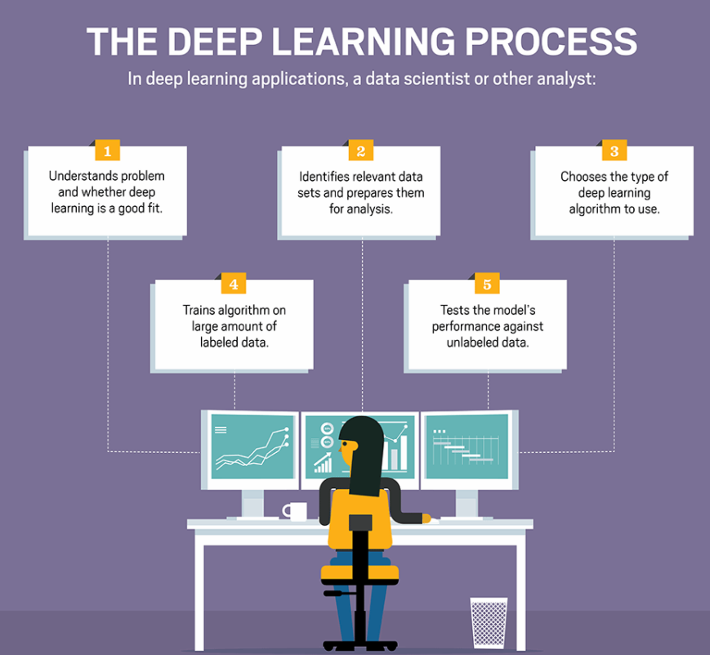
Course Introduction Continued
Part-2:
What is Deep Learning (DL)?
It is a machine learning technique that teaches computers to do what comes naturally to humans: learn by example – [Courtesy: WWW. Mathworks.com]
Image Source: https://searchenterpriseai.techtarget.com/definition/deep-learning-deep-neural-network

Slide 8
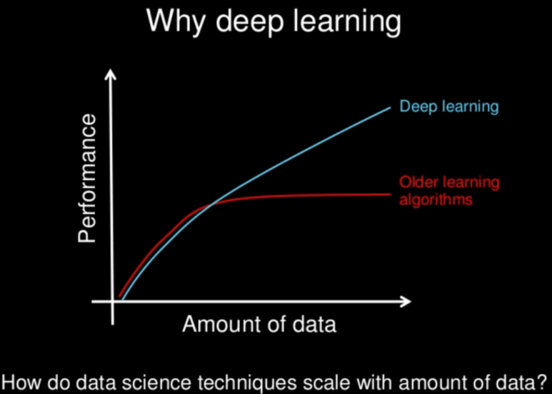
Course Introduction Continued.,
Need for Deep Learning (DL):
Powered by Massive amounts of data
Flexible system
No need for a separate Feature Extraction module
Tolerant to Imprecise Data
Model Nonlinear Functions of higher complex nature
No need for human supervision as like ML
Can be Blended easily into Traditional Control applications
Deep Learning is based on Artificial Neural Networks (ANN)
Deep Learning uses Multiple layers of ANN(Hidden layers)
Image Source: https://machinelearningmastery.com/what-is-deep-learning/

Slide 9
Course Introduction Continued.,
Applications of Deep Learning (DL):
Image/ Pattern Classification
Image/ Pattern Association
Self Driving Cars
News Aggregation and Fraud News Detection
Natural Language Processing
Visual Recognition
Fraud Detection
Healthcare
Automatic Handwriting Generation
Automatic Game Playing
Language Translations
Demographic and Election Predictions

Slide 10
Course Outcomes
SECA4002 – DEEP LEARNING NEURAL NETWORKS
At The end of this Course, Student will be able to
CO1 | Select suitable model parameters for different machine learning techniques
CO2 | Evaluate the performance of existing deep learning models for various applications
CO3 | Realign high dimensional data using reduction techniques
CO4 | Analyze the performance of various optimization and generalization techniques in deep learning
CO5 | Modify the existing architectures for domain specific applications
CO6 | Develop a real time application using deep learning neural networks

Slide 11
Course Objectives
SECA4002 – DEEP LEARNING NEURAL NETWORKS
Course Objectives:
To present the mathematical, statistical and computational challenges of building neural networks
To study the concepts of deep learning
To introduce dimensionality reduction techniques
To enable the students to know deep learning techniques to support real-time applications
To examine the case studies of deep learning techniques

Slide 12
SECA4002 – DEEP LEARNING NEURAL NETWORKS
Detailed Syllabus:
UNIT 1: INTRODUCTION TO DEEP LEARNING
Introduction to machine learning- Linear models (SVMs and Perceptron’s, logistic regression)- Intro to Neural Nets: What a shallow network computes- Training a network: loss functions, back propagation and stochastic gradient descent- Neural networks as universal function approximates

Slide 13
SECA4002 – DEEP LEARNING NEURAL NETWORKS
Detailed Syllabus:
UNIT 2: DEEP NETWORKS
History of Deep Learning- A Probabilistic Theory of Deep Learning- Backpropagation and regularization, batch normalization- VC Dimension and Neural Nets-Deep Vs Shallow Networks Convolutional Networks- Generative Adversarial Networks (GAN), Semi-supervised Learning
UNIT 3: DEEP NETWORKS
Linear (PCA, LDA) and manifolds, metric learning - Auto encoders and dimensionality reduction in networks - Introduction to Convnet - Architectures – AlexNet, VGG, Inception, ResNet - Training a Convnet: weights initialization, batch normalization, hyperparameter optimization

Slide 14
SECA4002 – DEEP LEARNING NEURAL NETWORKS
Detailed Syllabus:
UNIT 4: OPTIMIZATION AND GENERALIZATION
Optimization in deep learning– Non-convex optimization for deep networks- Stochastic Optimization Generalization in neural networks- Spatial Transformer Networks- Recurrent networks, LSTM Recurrent Neural Network Language Models- Word-Level RNNs & Deep Reinforcement Learning - Computational & Artificial Neuroscience
UNIT 3: APPLICATIONS OF DEEP LEARNING
Imagenet- Detection-Audio WaveNet- Natural Language Processing Word2Vec - Joint Detection BioInformatics- Face Recognition- Scene Understanding- Gathering Image Captions

Slide 15
SECA4002 – DEEP LEARNING NEURAL NETWORKS
Recommended Text Books/ Reference Books
Cosma Rohilla Shalizi, Advanced Data Analysis from an Elementary Point of View, 2015.
Deng & Yu, Deep Learning: Methods and Applications, Now Publishers, 2013.
Ian Goodfellow, Yoshua Bengio, Aaron Courville, Deep Learning, MIT Press, 2016.
Michael Nielsen, Neural Networks and Deep Learning, Determination Press, 2015.

Slide 16
UNIT-1 Introduction To Machine Learning

Slide 17
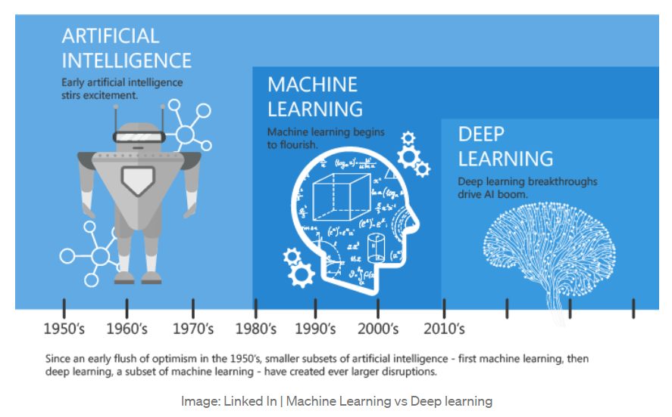
Introduction - Machine Learning

Slide 18
Introduction - Machine Learning
The term Machine Learning was coined by Arthur Samuel in 1959
Machine learning is a specific subset of AI that trains a machine how to learn
Machine learning is a branch of artificial intelligence (AI) and computer science which focuses on the use of data and algorithms to imitate the way that humans learn, gradually improving its accuracy. (Courtesy: www.ibm.com)
Machine learning algorithms use computational methods to “learn” information directly from data without relying on a predetermined equation as a model. The algorithms adaptively improve their performance as the number of samples available for learning increases.

Slide 19
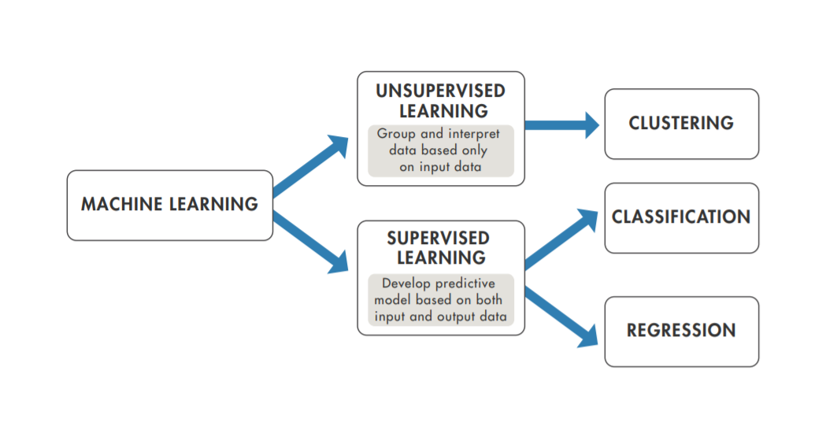
Introduction - Machine Learning
How Machine Learning (ML) Works?
Courtesy: https://in.mathworks.com/content/dam/mathworks/ebook/gated/machine-learning-ebook-all-chapters.pdf

Slide 20
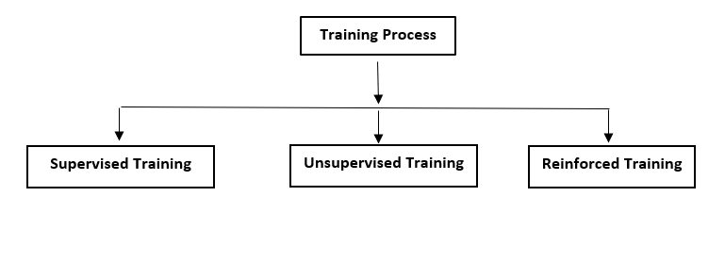
ARTIFICIAL NEURAL NETWORK(ANN)
Training Process
Training process of an Artificial Neural Networks can be broadly classified as
Supervised Training
Unsupervised Training
Reinforced Training

Slide 21
Supervised Learning
Supervised Learning is the process of an learning(from the training dataset) can be thought of as a teacher who is supervising the entire learning process
Learning algorithm iteratively makes predictions on the training data and is corrected by the “teacher”, and the learning stops when the algorithm achieves an acceptable level of performance(or the desired accuracy)
Supervised learning is the learning of the model where with input variable ( say, X) and an output variable (say, Y) and an algorithm to map the input to the output. Y = f(X)

Slide 22
Supervised Training Algorithms
Any Algorithm which implements the supervised Training process is called Supervised Training Algorithms
Key Points:
Each Input Vector is allotted with a corresponding Target vector
The training Pair =[Input vector, Target Vector]
Weights are adjusted to minimize the Difference between the Actual output & the Desired outputs
Actual output = Output provided by the ANN
Desired output = Output specified by the user (Target)

Slide 23
Supervised Training Algorithms- Continued
Supervised Training Procedure
Explanation:
Assume that a teacher is present
Network is provided with the inputs & its associated outputs
After processing based on Learning Law the network provides the output(Actual output)
This out is compared with the Desired (Target) value
If the desired value is Not Equal to the actual output ,then the teacher informs that an error has occurred error
Now the teachers helps us in changing the weight (Based on learning Law)
The process of Weight updating is continued until the desired output is Equal to the actual output ( Stop Condition of the training Algorithm)

Slide 24
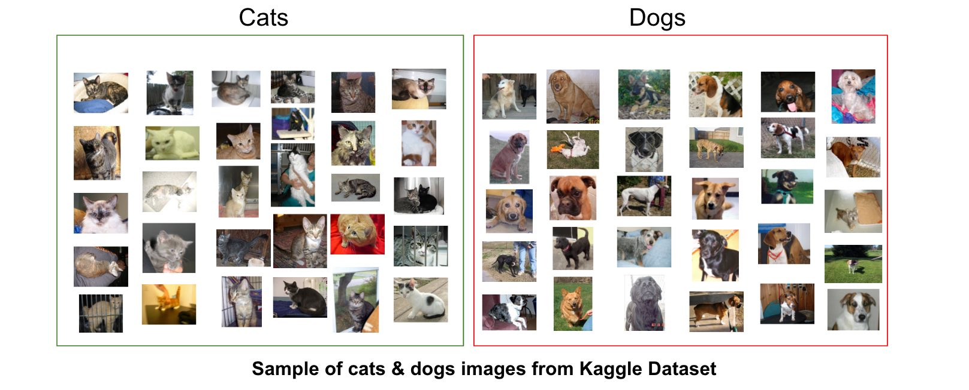
Supervised Learning

Slide 25
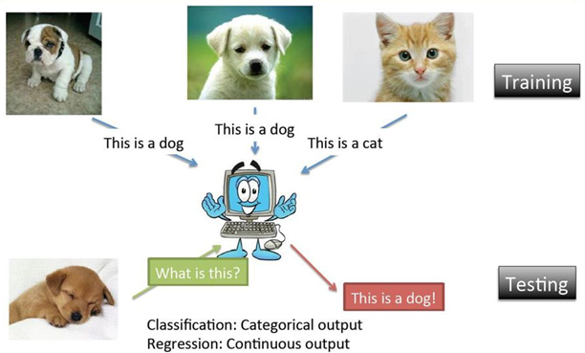
Supervised Learning

Slide 26
Unsupervised Training Algorithms
Any Algorithm which implements the Unsupervised Training process is called Unsupervised Training Algorithms
Key Points:
No Target is provided
Let to discover the target pattern on its own
No Teacher (Error detecting mechanism) is present
Iterative process
Consumes more time to converge(stop condition)
More Accurate when compared with Supervised Training procedure
Used to group unstructured data based on distinct features available within the data set

Slide 27
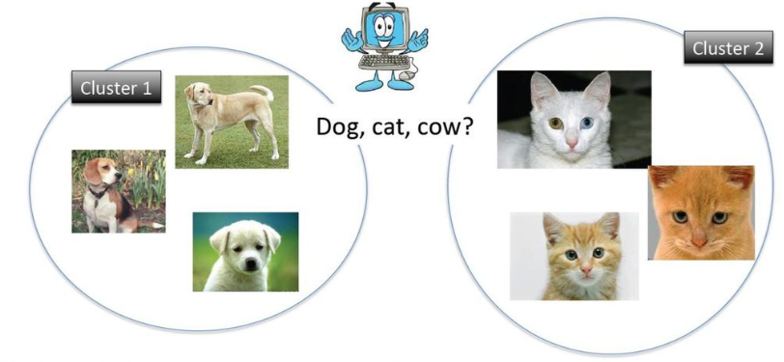
Unsupervised Learning

Slide 28
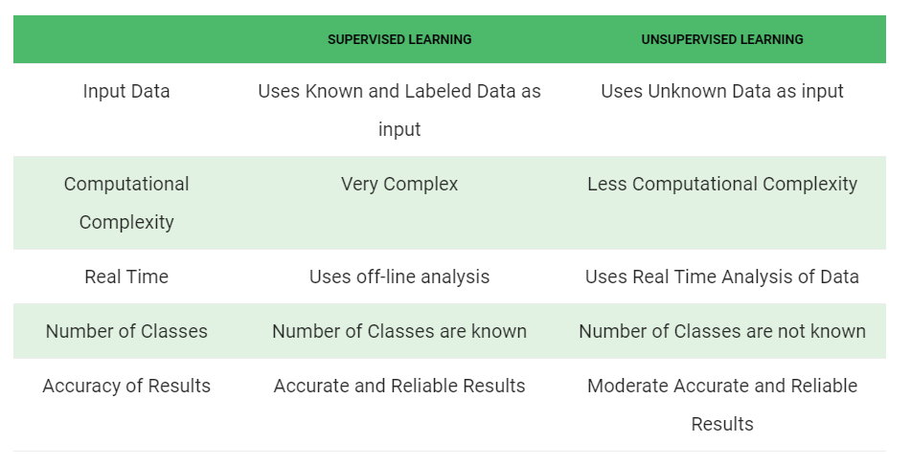
Comparison Between Supervised & Supervised

Slide 29
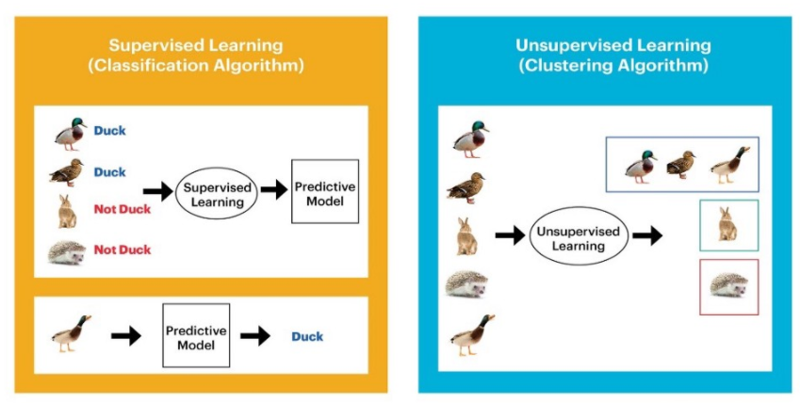
Comparison Between Supervised & Supervised

Slide 30
Reinforced Training Algorithms
Any Algorithm which implements the Unique learning process in which the data’s are not given, but generated by interactions with the environment is called Reinforced Training Algorithms
Points to Ponder:
A teacher is present but does not specifies the Target
The teacher just specifies the obtained output has correct or not
Error detection is present but no error correction
A reward is provided if the output is correct
A penalty is provided for wrong answer
Aim is to maximize the reward process by Trail & error process
The network has to exploit what it already knows in order to obtain reward
It also has to explore new unknown searches in order to make better action selections in the future

Slide 31
Reinforced Learning
Reinforcement learning differs from the supervised learning
In supervised learning the training data has the answer key with it so the model is trained with the correct answer itself
In reinforcement learning, there is no answer but the reinforcement agent decides the action to be done based on the current state/Environment
Agent interprets based on the given input
If the action is good/best then a reward is provided
Unsupervised learning is done
Else a penalty is given
Supervised learning is done i.e weights are changed based on the error

Slide 32
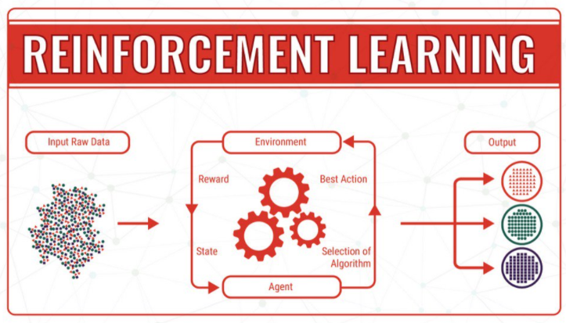
Reinforced Learning
Image source: https://twitter.com/ipfconline1/status/1034281946380218369/photo/1

Slide 33
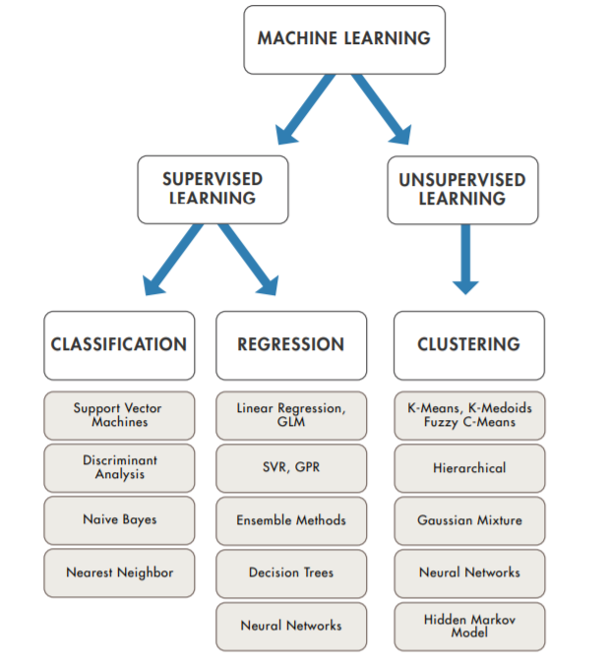
Introduction – Contd.,
How Do You Decide Which Algorithm to Use?
Courtesy: https://in.mathworks.com/content/dam/mathworks/ebook/gated/machine-learning-ebook-all-chapters.pdf

Slide 34
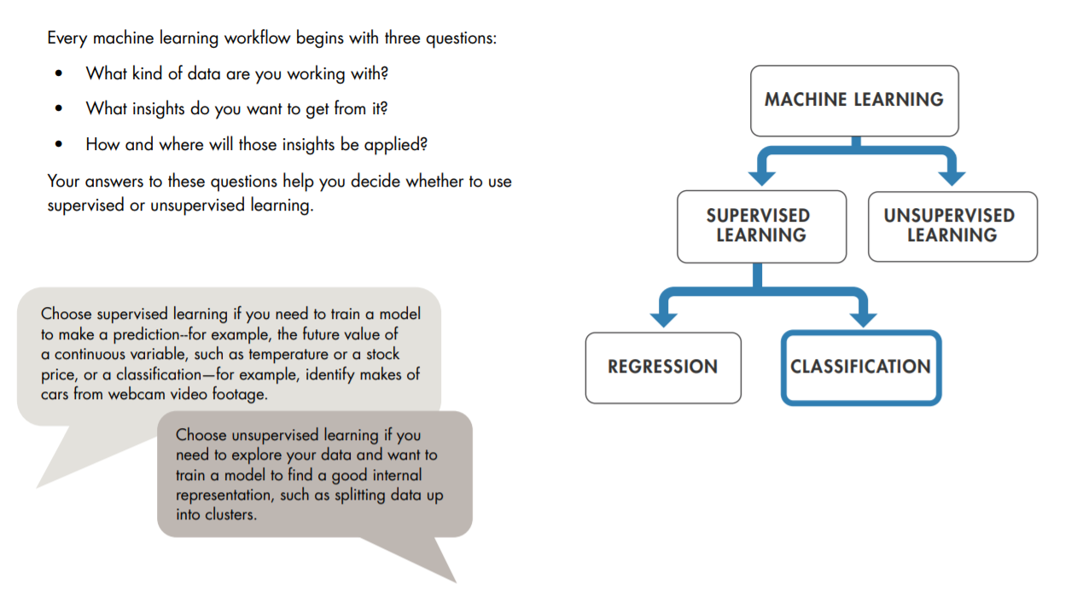
Questions to Consider Before You Start
Courtesy: https://in.mathworks.com/content/dam/mathworks/ebook/gated/machine-learning-ebook-all-chapters.pdf

Slide 35
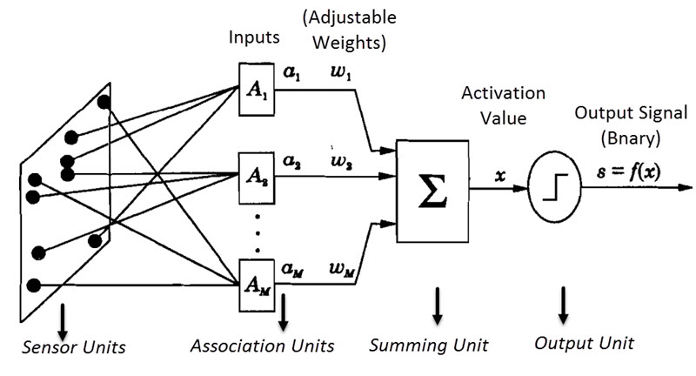

Models of ANN contd.
I. Perceptron Model
I. a. Single Layer Perceptron Model
Activation Function
Output Signal s = f(x)
Error δ = b-s
Weight change Δw= η δ a_{i}

Slide 36
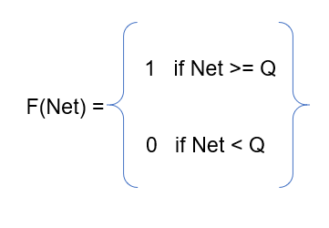
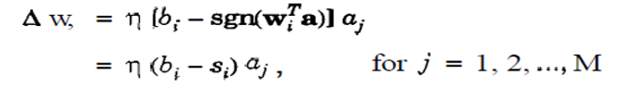
Single Layer Perceptron Model Algorithm
Algorithm:
Initialize the weights to some small random values near to Zero
Apply the Input : Output Training patterns ( Vector Pairs)
Calculate the summing part value Net = Σ aiwi-θ
Apply Activation function and calculate the output
_{Calculate the Error} δ = b_{i}-Si , if error is present then update the weight for that link using

Slide 37
Single Layer Perceptron Model Algorithm
Algorithm ( Continued)
6. Similarly change the Bias values
New Bias = old Bias + change in Bias
7. Now repeat from step 3
8. Check for error ,if error is present repeat the process ,Else Stop
Limitations:
Uses only Binary Activation function
Can be used only for Linear Networks
Since uses Supervised Learning ,Optimal Solution is provided
Training Time is More
Cannot solve Linear In-separable Problem
In order to solve these limitations, Multi Layer Perceptron is Implemented

Slide 38
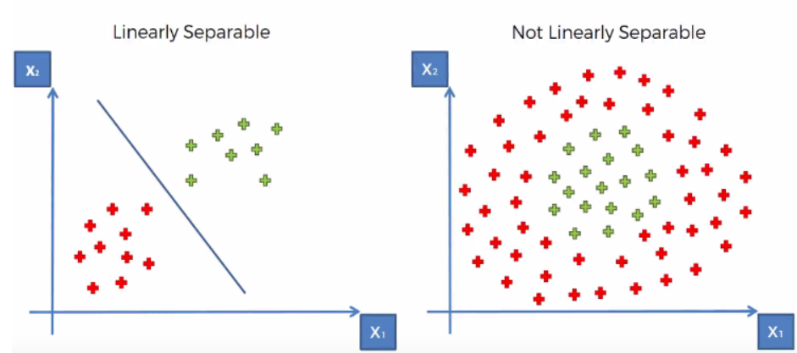
Linear separable & Linear Inseparable issue
Let us consider AND Gate as example for Linear separable and XOR Gate for Linear Inseparability

Slide 39
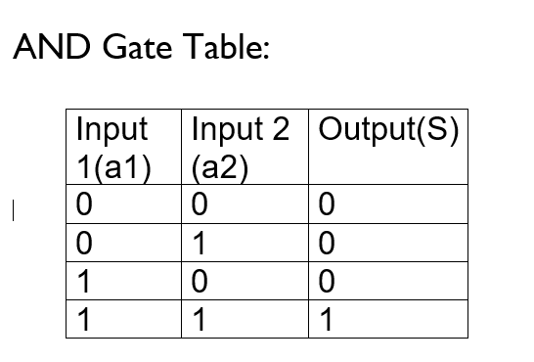
Linear separable & Linear Inseparable issue
1,1
1,0
Decision Boundary Line
B₀+w₁x₁+w₂x₂ =0
w₂x₂ = - B₀ - w₁x₁
X₂ = - B₀ - w₁ x₁
w₂ w₂
0,0
This equation is similar to Line equation
0,1
Let us consider AND Gate as example for Linear separable analysis
Denotes a Binary Value of ‘1’
Denotes a Binary Value of ‘0’

Slide 40
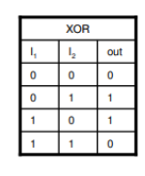
Linear separable & Linear Inseparable issue
Let us consider XOR Gate for Linear Inseparability
1,1
1,0
Denotes a Binary Value of ‘1’
Denotes a Binary Value of ‘0’
0,0
0,1
Here a single decision Line cannot separate the Zeros and Ones Linearly
At least Two lines are required to separate Zeros and Ones
With Single Layer networks we can have only one decision Line, so to solve non Linearity or Linear Inseparable problems Single Layer Networks cannot be used
To Overcome this Problem We use Convex Regions

Slide 41
Linear separable & Linear Inseparable issue
Convex Region:
Select any Two points in a region and draw a straight line between these two points. If the points selected and the lines joining them both lie inside the region then that region is known as convex regions
Types:
(a) Open Convex region (b) Closed Convex Region
To over come Linear Inseparable problem we need at least minimum two or more decision lines, Hence we move towards Multi Layer Networks

Slide 42
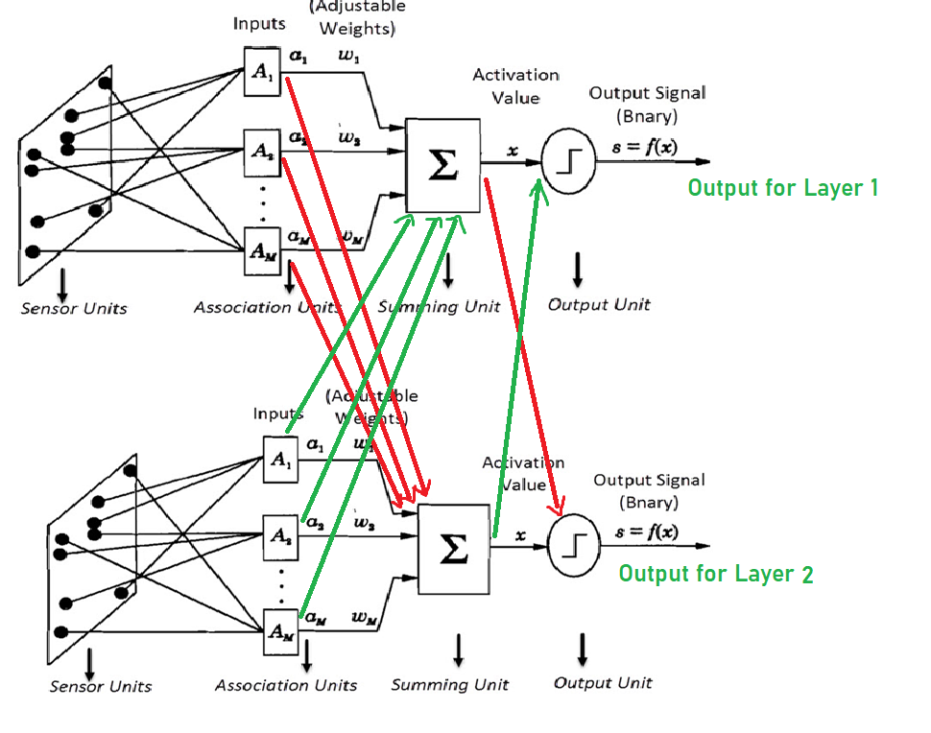
I. Perceptron Model
II. b. Multi Layer Perceptron Model

Slide 43
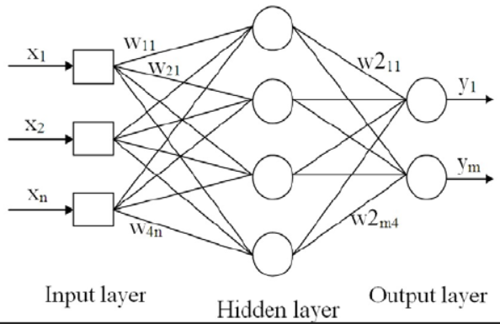
I. b. Multi Layer Perceptron Model
Activation Function
Output Signal s = f(x)
Error δ = b-s
Weight change Δw= η δ a_{i}

Slide 44
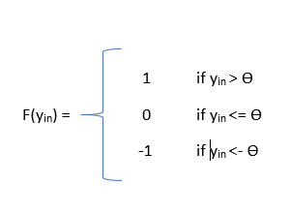
II. b. Multi Layer Perceptron Model
Algorithm:
Initialize the weights (W_{i}) & Bias (B₀) to small random values near Zero
Set learning rate η or α in the range of “0” to “1”
Check for stop condition. If stop condition is false do steps 3 to 7
For each Training pairs do step 4 to 7
Set activations of Output units: x_{i} = s_{i} for i=1 to N
Calculate the output Response
y_{in} = b₀ + Σ x_{i}w_{i}
Activation function is
For Multi Layer networks, based on the number of layers steps 6 & 7 are repeated
Y =
Bipolar Activation is used

Slide 45
I. b. Multi Layer Perceptron Model
Algorithm: (Continued)
If the Targets is (not equal to) = to the actual output (Y), then update weights and bias based on Perceptron Learning Law
W_{i (new)} = W_{i (old)} + Change in weight vector
Change in weight vector = ηt_{i}x_{i}
Where η = Learning Rate
t_{i} = Target output of i^{th} unit
x_{i} = i^{th} Input vector
b_{0(new)} = b_{0 (old)} + Change in Bias
Change in Bias = ηt_{i}
Else W_{i (new)} = W_{i (old)}
b_{0(new)} = b_{0 (old)}
9. Test for Stop condition

Slide 46

This Photo by Unknown Author is licensed under CC BY
Any Doubts /Questions Pls Contact The Course Coordinator
The copyright for all the diagrams/ screen shots lies with the respective owners
Citations are provided at appropriate places

